Slide 1
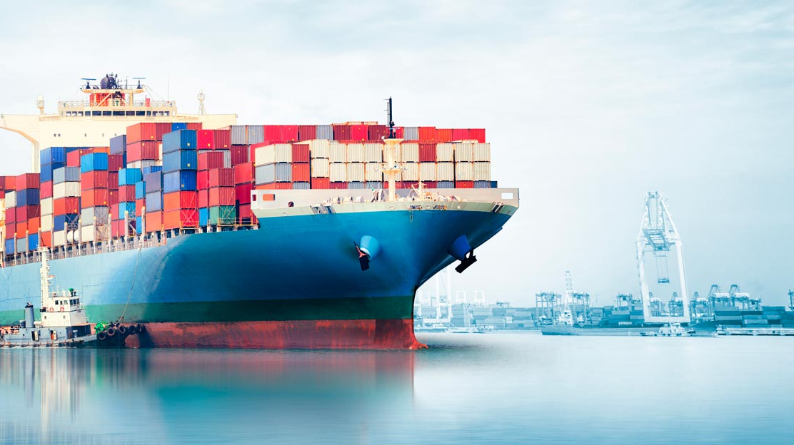
Progress sprint 8 @ Saab
08-01-2020

Slide 2
Content
Results NN
Resuts statistical approach
Prototype

Slide 3
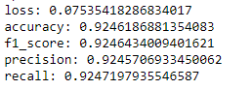
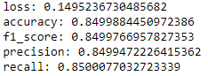
Results NN
No more rotating, angular speed
RMSE
Speed * 5
Speed * 2

Slide 4


Results NN
Binary Crossentropy
Speed / 5
Speed / 2
Linked with prototype – later this presentation

Slide 5
Results statistical approach:
Using KDE to approximate the density distribution of the feature evaluated at each node.
So far implemented for speed and direction
Currently evaluating speed tolerancy
Implemented a buffer with 5 steps to clear the noise (little anomalies that do not make sense at all:
Detecting:
As BLUE: Anchored ships → They should be treated differently → working on that
As ORANGE: Trajectories for which we do not have enough info to conclude anything
As RED: Anomaly according to the historical data in the surroundings of the point
As GREEN: Normal behaviors.
To get printed as RED, ORANGE or BLUE we take into account 5 steps.
If within those 5 steps more than the 60% of the transitions have been labeled under the same color, the transition we are evaluating will get the same color.

Slide 6
This week. Statistical Approach
Apply the algorithm to the rest of the features.
Get a unique model from this. Two options
Throw anomalies specifying from which feature they come.
E.g.: SHIP GOING TO FAST / SHIP FACING A WEIRD DIRECTION / SHIP ROTATING TOO FAST (...).
Try to ponderate all probabilities:
E.g.: ANOMALY/NORMAL

Slide 7
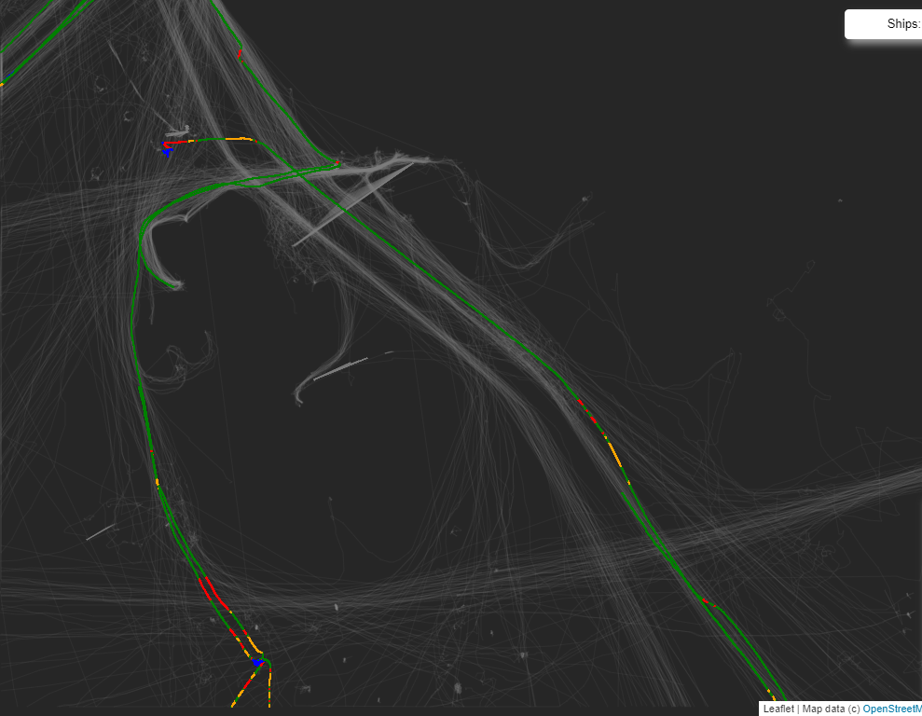
Results. Direction
Sudden change on the course
Weird direction
Probably crossing an area where ships go towards the opposite direction (Kind of Noise)
Crossing a road

Slide 8
Prototype
HTML file (downloaded)

Slide 9
Summary
Results NN
Resuts statistical approach
Prototype

